Slide 1
Chinese Market Research Affordability on Exported Oncology Drugs Jizhen HUANG

Slide 2
Objective
Understand the volume estimation practice in China
Understand the threshold of population layers that have the affordability of -exported oncology drugs (Out-of-Pocket Market)
Explore the affordability under the scheme of commercial health insurance coverage

Slide 3


Pharma companies in China tend to neglect the private market size and focus mainly on the public hospital channels
Pfizer China Rare Disease | Sanofi China Oncology
“Especially for rare diseases with a low incident rate, the target population is too small, we believe that all the potentials are in the tier 3 hospitals in core cities (Tier 1 & Tier 2 cities)”
“We don’t think it is necessary to estimate the volume of private market in China because almost all patients go to public hospitals”.
Public | Private
City hospital | Private Hospital
County Hospital | Chinese Medecine Hospital
CHC (Community Health Center) | Neurology Institute
 | Online/ Rx Direct to Patient Pharmacies
Note: All hospitals need to be classified by the government, each one received a certificate of ranking, Tier 3 is the best and located in cities. Source : 1 to 1 interview with alumni

Slide 4




In terms of patient pathway, patients go directly to the hospitals and oncology patients prefer public Tier 3 public hospitals instead of private ones in core cities.
Visit/Prescription
Rx Purchase
Public Hospital
HP Pharmacy
1
Patient Pathway in China
Onco patients prefer public Tier 3 hospitals instead of private ones (public ones are guaranteed with far better resources and qualified physicians) in the core (tier 1 – 2) cities.
Private Hospital
CHC
Patient outflow
CHC
Offline
Retail
2
Rare disease with low incidence
As public hospitals are easily access with all the population, rare disease patients usually prefer go to regional capital cities for treatment
Online
Retail
Note: CHC : Community Health Center, source : IQVIA

Slide 5
Regarding reimbursement process, Hospital Rx sales remain the most significant channel in China up to date due to full reimbursement
1
Market Challenges: Limited Market out of HP
2
Policy Constraints: Online medicine can not be reimbursed
Most Rx sales happens in the HP, leaving limited market for retail and online sales channel
Rx e-commerce is facing challenges
- Online prescription system is underdeveloped
- Online medicine can not be reimbursed
Market Sales Comparison
(2015 - 2017, Bn Euro)
Hospital
Retail
CHC
139
145
128
E-prescription system is underdeveloped:
Online Rx sales will need E-prescription but most of the prescription is still on paper now
76%
77%
76%
Online medicine can not be reimbursed：
Due to the unmatured market and regulation system, it might take a long time for medical insurance to cover the online medicine
2015
2016
2017
11%
10%
10%
13%
13%
14%
Source : IQVIA

Slide 6
An example of sales estimation using CHPA audit and CHC audit data – Diabetes market competitive landscape project
XXX Sales Revenue by Channel in China
(2018-2020, Mn RMB)
+8%
+8%
11,594
Channel segment | Share (2020) | 3 Year CAGR | Growth contribution
City hospital | 46% | +5% | 28%
County hospital | 31% | +20% | 60%
Community health center | 8% | +14% | 17%
Retail pharmacy | 15% | -5% | -4%
10,763
9,969
5,300 (46%)
5,069 (47%)
Hospital channel contributed 85% of XX’ s total revenue, in which county market contributes most (60%) for the NN’s growth
4,816 (48%)
3,062 (28%)
3,557 (31%)
2,459 (25%)
753 (8%)
843 (8%)
984 (8%)
1,941 (19%)
1,790 (17%)
1,753 (15%)
2018
2019
2020
Source: IQVIA CHPA audit, COUNTY audit, CHC audit; IQVIA analysis

Slide 7
Data source for the estimation of treatment cost – a diabetes project example
Key area
Key Data Title
Data Source
Population by Province
China Statistical Yearbook
PDS (7000 Patient Record per year) info
WHO standard historical project data
PDS record information by percent
PDS record information by percent
CHPA by brand volume
CHPA by brand volume
Demographic Database
Core cities of Provinces
Prevalence/Diagnosis/ Treatment/ T2DM rate
Regimen Choice
Class 1 by percent
Class 2 by percent
Key Brand Sale Volume
Class 1
Class 2
Note : Simplified model based on the project experience. PDS : China diabetes patients cards

Slide 8
According to China Bureau of Statistics, the highest income level group (20%) has the average disposable income of 95,055 CNY (12,187 Euro) in 2023
 | Mean | Median
All | 39,218 | 33,036
 | Euro 5027 | Euro 4235.38
City | 51,821 | 47122
 | Euro 6644 | Euro 6041
Village | 21,691 | 18,748
 | Euro 2781 | Euro 2404
EURO | 12,187 | 6,438 | 4128 | 2620 | 1184
Source : China Bureau of Statistics. Currency : 1Euro : 1 CNY = 7.8

Slide 9
According to Statistical Yearbook, the highest income level group (20%) has the average income of 90116.3 CNY ( 11,553 Euro) in 2022
 | Mean | Median
All | 36883 | 31370
 | Euro 4729 | Euro 4022
City | 49283 | 45123
 | Euro 6318 | Euro 5758
Village | 20133 | 17734
 | 2851 | 2274
ALL | 11553.37 | 6076.205 | 3922.859 | 2474.705 | 1102.705
CITY | 13746.68 | 7913.346 | 5677.295 | 3997.385 | 2175.731
Village | 5907.103 | 3159.769 | 2237.256 | 1534.013 | 644.1795
Source : China Statistical Yearbook 2023, Currency : 1Euro : 1 CNY = 7.8

Slide 10
0.428% of the total population are high net worth individuals (HNWI) with asset exceeding 1 million USD in 2022
Number of people
Description: This statistic indicates the number of people owning more than ten million yuan in mainland China as of January 2022, by region. In January 2022, approximately 306,000 millionaires lived in Beijing, whereas around 307,000 millionaires lived in Guangdong province. Read more
Note(s): China; January 2022
Source(s): Hurun Research Institute

Slide 11
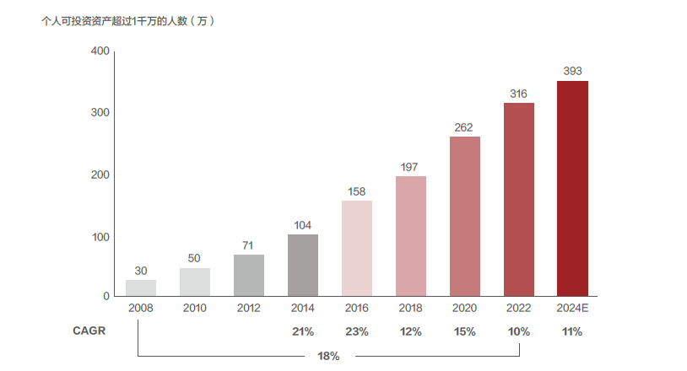
0.002% of the total population has the investable assets exceeding 10 million RMB in 2022
Number of individuals with investable assets exceeding 10 million RMB (10,000 per.) / 1.28mn Euro
Source : 2022 China Wealth Management Report, Bain

Slide 12


2 interviews are conducted to understand the landscape of income level in China as well as the commercial health insurance potential
Healthcare Investor | Insurance Agent
“ In terms of the market entry pathway, I feel that either entering NRDL or not can be the options, there are successful cases for both scenario;
I feel that for the OOP affordability on imported oncology drugs, people need have the yearly income of more than 600K CNY (77K Euro) “
“In our local market, the basic coverage of severe diseases is not high, for adult is about 200 – 300K, for kids is about 500K.
There is one type of insurance that the coverage can reach to 6 million and the drugs are not limited to NRDL, but it should be the prescription from physicians.
In general, for this type of insurance, we will reimburse the patients once they get diagnosed ”
Source : 1 to 1 interview

Slide 13
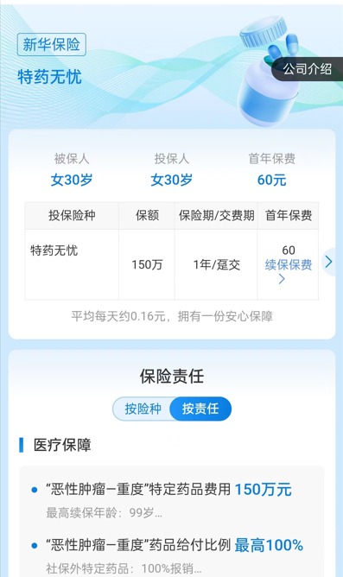
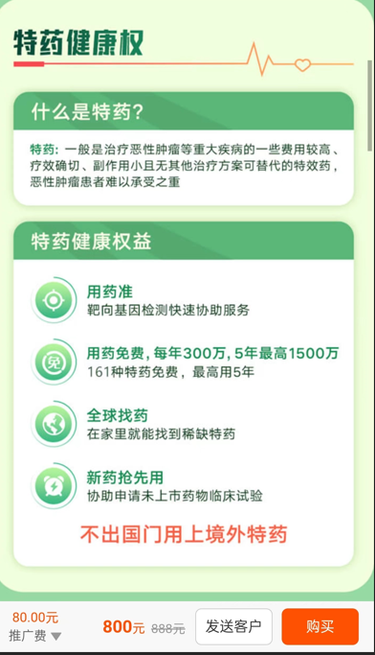


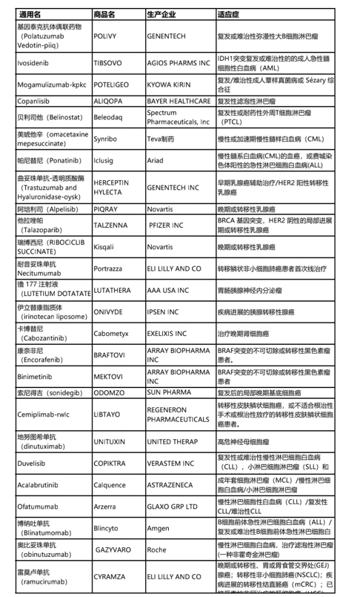
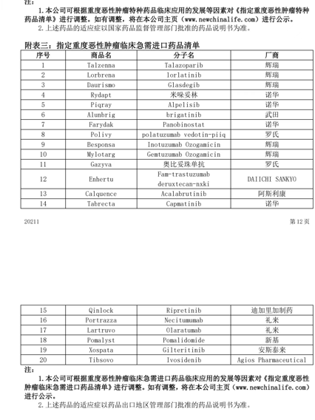
Examples of severe diseases drug commercial insurances
For certain imported cancer drugs, you can get reimbursement if you buy from appointed pharmacies ( up to 1.5 million)
More than 160 imported cancer drugs are included
Source : 1 to 1 interview

Slide 14
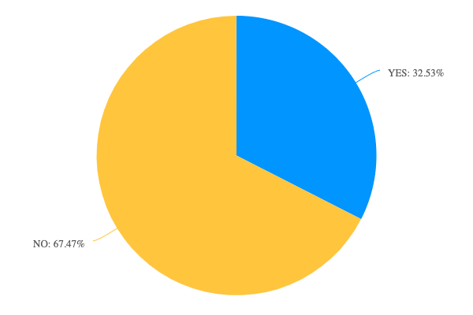
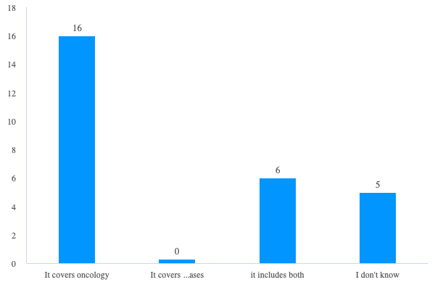
Among 83 respondents, 27 purchase(d) commecial health insurance, while 16 covering oncology, 6 covering both and 5 Not clear
Q1 : Do you purchase (or have you purchased) commercial health insurance for yourself or your family members?
Q2 : Does your health insurance cover oncology or rare diseases?
27
56
Source : Survey of 83 samples

Slide 15
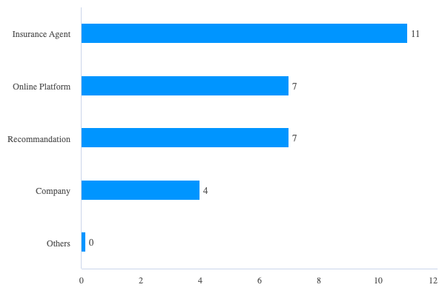
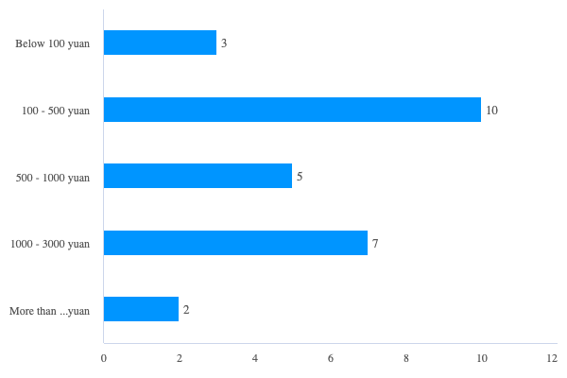
Among 27 respondents, monthly costs of 100 – 500 yuan are the most popular type and insurance agent is the most common channel to purchase
Q4 : You spend how much per month on the health insurance?
Q5 : Through which channel(s) did you purchase your health insurance?
More than 3000 Yuan
Source : Survey of 83 samples

Slide 16
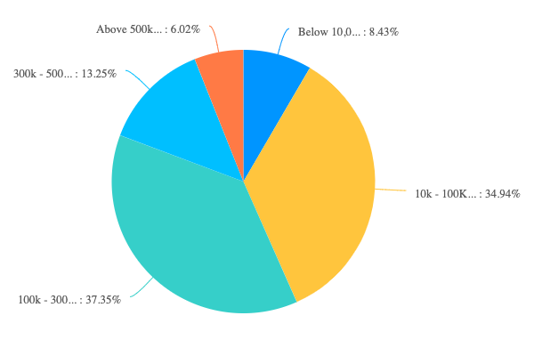
Percentage of insurance buyers increase as the income level increases compared to all respondents
Income level breakdown for all respondents
5
7
11
29
31
Source : Survey of 83 samples

Slide 17
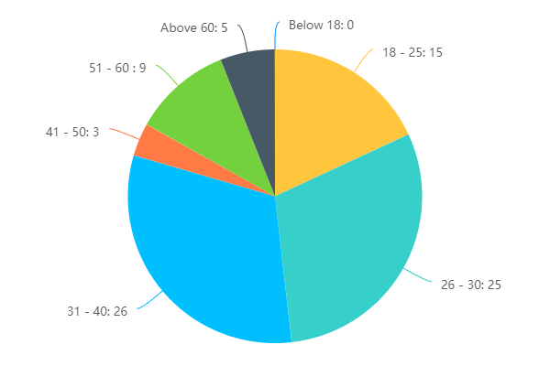
Buyers from the age group from 26 to 30 and 31 to 40 accounts for the 70% of the total number of buyers
Age breakdown for all respondents
Age breakdown for buyers
6.02%
18.07%
10.84%
3.61%
30.12%
31.33%
Source : Survey of 83 samples

Slide 18
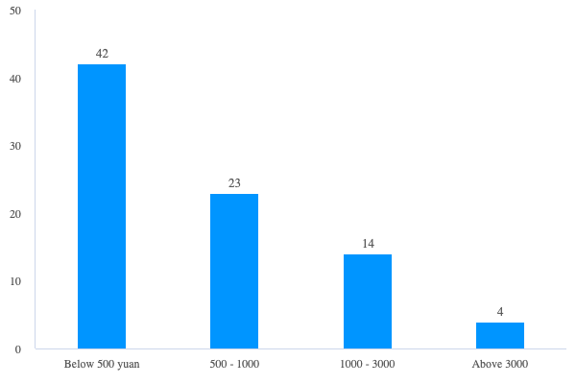
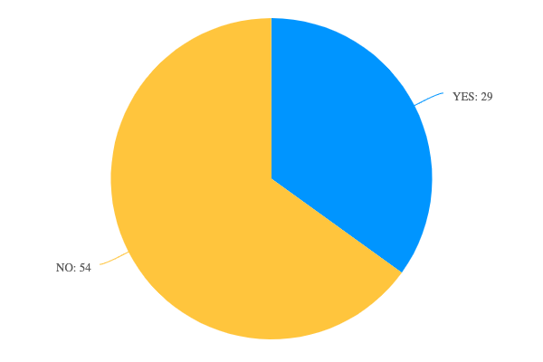
Willingness to pay – Among 83 effective responses, 50.6% prefers pay less than 500 while 4.8% prefer pay more than 3000 yuan per month; 65% of the respondents are reluctant to change or buy plans for more imported drugs
Q6 : How much are you willing to pay per month for health insurance that including cancers and rare diseases?
Q7 :Will you consider change or purchase a new plan for more exported drugs?
50.6%
27.7%
16.9%
4.8%
Source : Survey of 83 samples

Slide 19
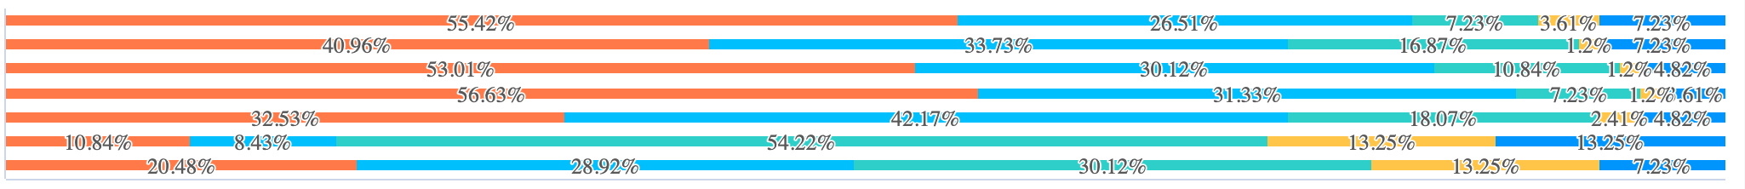
Willingness to pay – Among 7 attributes, simple claim process stays the most important reason, followed by coverage of the diseases
Q8 : Please rate on the scale of importance on each of the attributes for you to purchase
Coverage of the diseases
Coverage of imported drugs
Affordable payment
Simple claim process
Trust brands
Recommandations
Type of Insurance
5 Most important
4
3
2
1
Type of insurance : consumer or financial products
Source : Survey of 83 samples

Slide 20
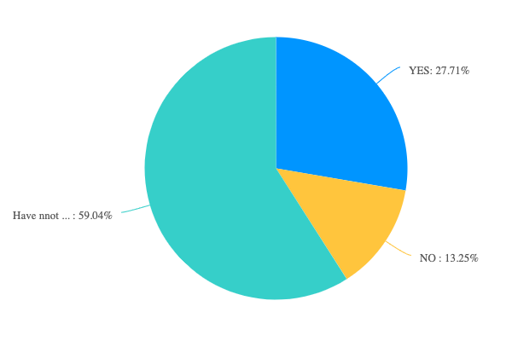
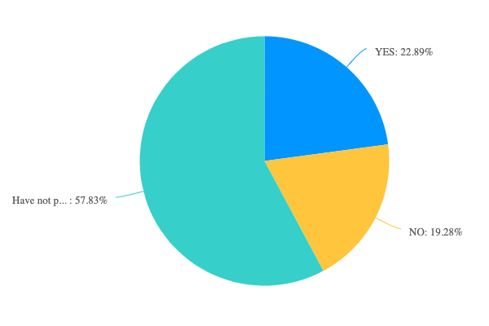
70% of the respondents experienced or recognised somone been diagnosed of rare diseases or cancer, while 49% is aware of people purchased health insurance
Q9 : Are you satisfied with the cancer type coverage of commercial healthcare insurance?
Q10 : Are you satisfied with the drug coverage of the commercial healthcare insurance?
The requirement is high while the percentage of reimbursement is low | The new drugs and imported drugs are often excluded
Coverage is still limited | The drugs with high efficacy are not included
The criteria is not clear | There are limitations on the reimbursement
Source : Survey of 83 samples

Slide 21
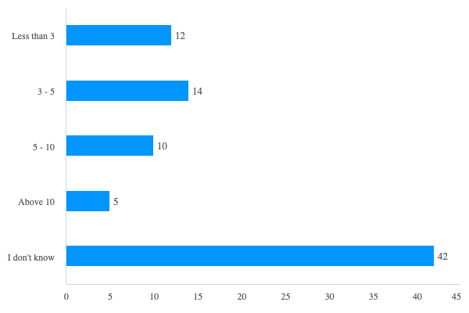
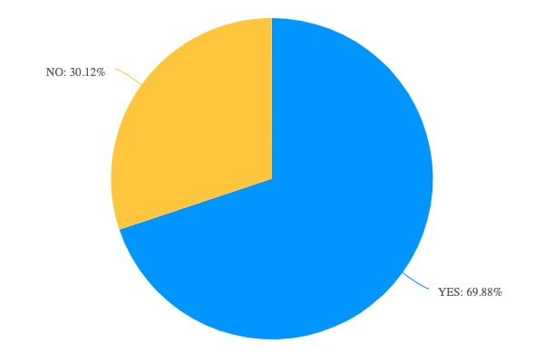
70% of the respondents experienced or recognised somone been diagnosed of rare diseases or cancer, while 49% is aware of people purchased health insurance
Q11 : Have you or someone you know even been diagnosed with a rare disease or cancer?
Q12 : How many people do you know who purchase the severe diseases insurances?
Source : Survey of 83 samples

Slide 22
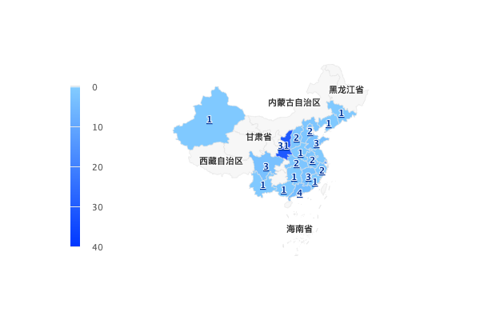
Sample demonstration
Source : Survey of 83 samples

Slide 23
Number of millionaires in mainland China from 2015 to 2022
Number of millionaires in China 2015-2022
9
Description: The statistic shows the number of millionaires in mainland China from 2015 to 2022, as estimated by a research institute in China. According to the report, there were 4.16 million millionaires owning assets worth over six million yuan - roughly equivalent to one million U.S. dollars - and 1,71 million millionaires with personal wealth of over ten million yuan in mainland China in 2022. Read more
Note(s): China; 2015 to 2022
Source(s): Hurun Research Institute

Slide 24
Annual growth rate of millionaires in mainland China from 2012 to 2022
Annual growth rate of millionaires in China 2012-2022
10
Description: The statistic shows the annual growth rate of millionaires in mainland China from 2012 to 2022. According to the report, Chinese millionaires owning six million yuan or more - which is roughly equivalent to one million U.S. dollars - registered a year on year growth rate of 2.2 percent in 2022. Read more
Note(s): China; 2012 to 2022
Source(s): Hurun Research Institute

Slide 25



Number of millionaires in mainland China in 2022, by region
Millionaires in China 2022, by region
Number of millionaires
11

Slide 26
Number of households owning 100 million yuan or more in mainland China from 2012 to 2022
Number of super rich people in China 2012-2022
12
Description: The statistic shows the number of super rich households in mainland China from 2012 to 2022. According to the report, there were around 115,580 super rich households owning assets worth 100 million yuan or more in China in 2022, increased from 111,560 in the previous year. Read more
Note(s): China; 2012 to 2022
Source(s): Hurun Research Institute

Slide 27
Number of households owning 100 million yuan or more in Greater China as of January 2022, by city
Number of super rich people in Greater China in 2022, by city
Number of super rich households
13
Description: This statistic shows the number of super rich households in Greater China as of January 2022, by city. In January 2022, approximately 20,400 households owning assets of 100 million Chinese yuan or more existed in Beijing. Read more
Note(s): China, Taiwan, Hong Kong; January 2022
Source(s): Hurun Research Institute

Slide 28
Breakdown of super rich individuals with personal wealth of 100 million yuan or above in Greater China as of January 2021, by occupation
Distribution of super rich individuals in Greater China as of 2021, by nature
Share of rich households
15
Description: Based on Hurun report on Greater China's rich individuals, 75 percent of super rich individuals in Greater China were entrepreneurs as of January 2021, while 10 percent were real estate investors. Read more
Note(s): China, Taiwan, Hong Kong; January 2021
Source(s): Hurun Research Institute

Slide 29
Ranking of the 22 richest people in China as of January 2023 (in billion U.S. dollars)
Ranking of the 22 richest people in China as of 2023
Wealth in billion U.S. dollars
16
Description: As of January 2023, Zhong Shanshan topped the list of the richest people in China with a net worth of 69 billion U.S. dollars. Ma Huateng, founder of the IT giant Tencent, and Zhang Yiming, founder of ByteDance and developer of TikTok and Toutiao, came in second and third respectively, while Ma Yun, founder of the IT giant Alibaba, fell back to the eighth place. Read more
Note(s): China; January 16th, 2023
Source(s): Hurun Research Institute

Slide 30

Premium revenue from health insurance in China from 2012 to 2022 (in billion yuan)
Health insurance premium revenue China 2012-2022
Note(s): China; 2012 to 2022
Further information regarding this statistic can be found on page 8.
Source(s): China Banking and Insurance Regulatory Commission; ID 1032552
6

Slide 31
Average annual per capita premium of high-end health insurance provided to employees by employers in China in 2021 (in yuan)
Annual per capita costs of high-end health insurance provided to employees China 2021
Note(s): China; 2021; among 112 enterprises; international enterprises accounted for 73 percent of all companies surveyed
Further information regarding this statistic can be found on page 8.
Source(s): Sohu; Mercer; ID 1369600
2

Slide 32
Breakdown of medical costs paid by high-end health insurance plans in China in 2021, by hospital type
Share of medical costs paid by high-end health insurances in China 2021, by hospital
Note(s): China; 2021; among 112 enterprises that offer high-end health insurances to their employees
Further information regarding this statistic can be found on page 8.
Source(s): Mercer; Sohu; ID 1369961
2

Slide 33
Popularity of medical fields covered by high-end health insurance plans in China in 2021
Popularity of medical sectors covered by high-end health insurances in China 2021
Share of insurances
Note(s): China; 2021; among 112 enterprises that offer high-end health insurances to their employees
Further information regarding this statistic can be found on page 8.
Source(s): Mercer; Sohu; ID 1369858
2

